Slide 1
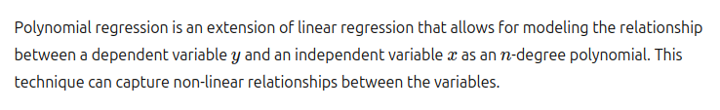
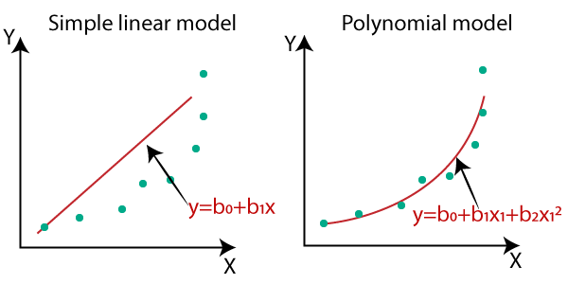
Polynomial Regression

Slide 2
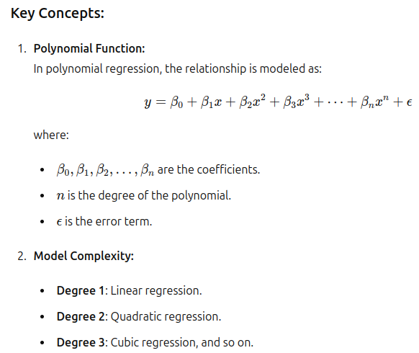

Slide 3
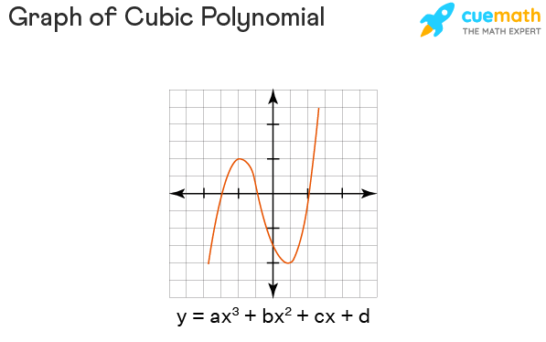
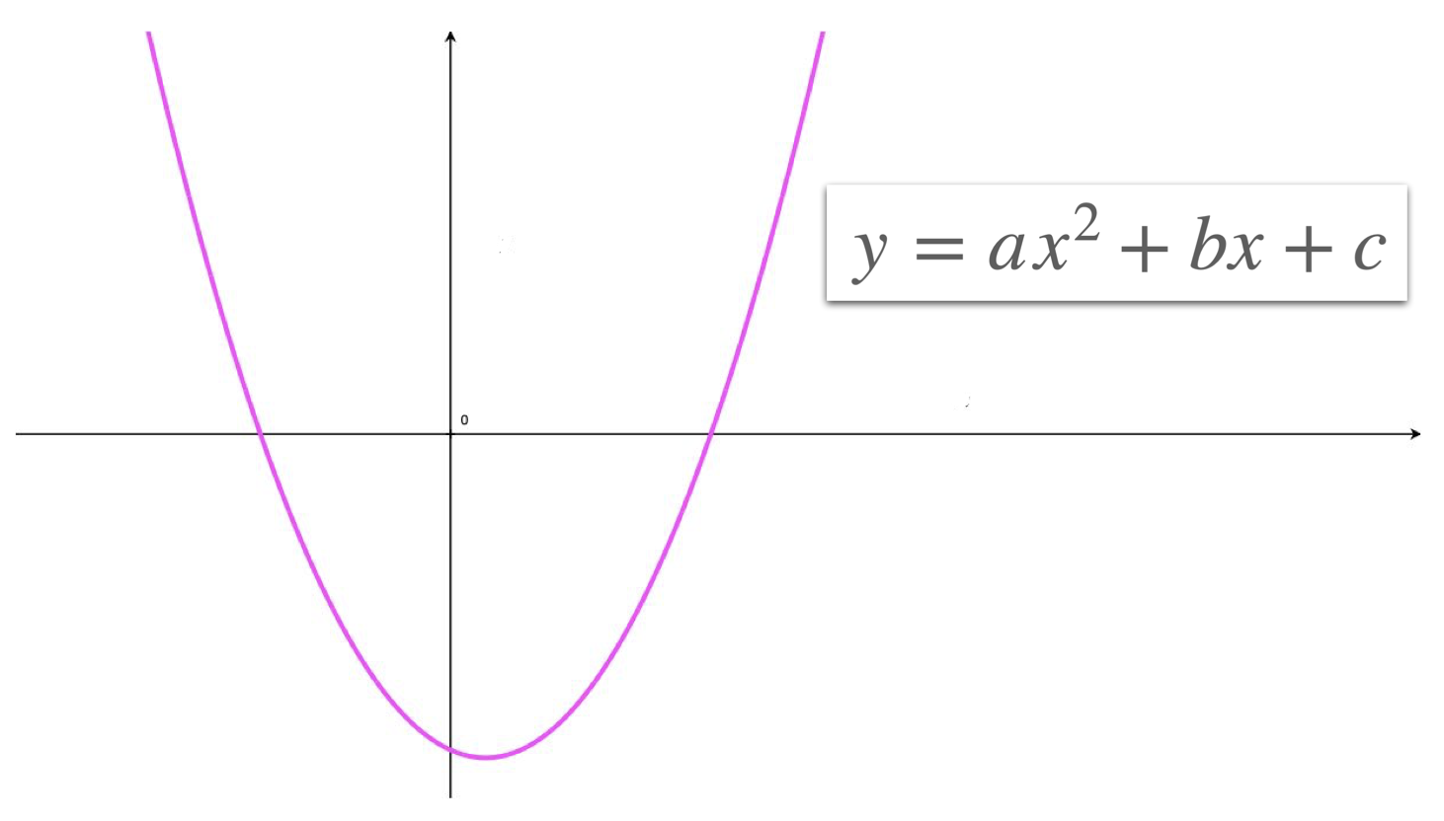

Slide 4


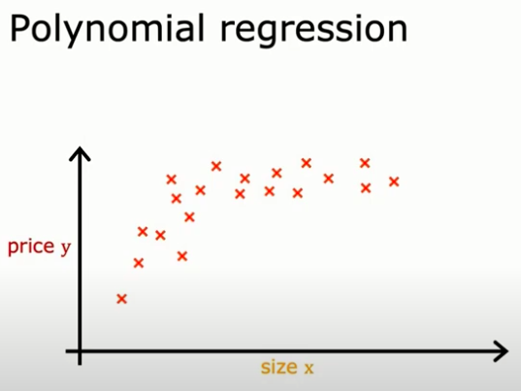

Slide 5
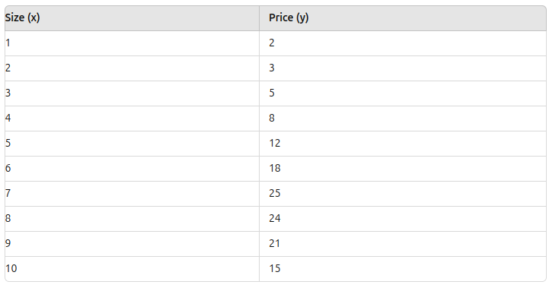

Slide 6
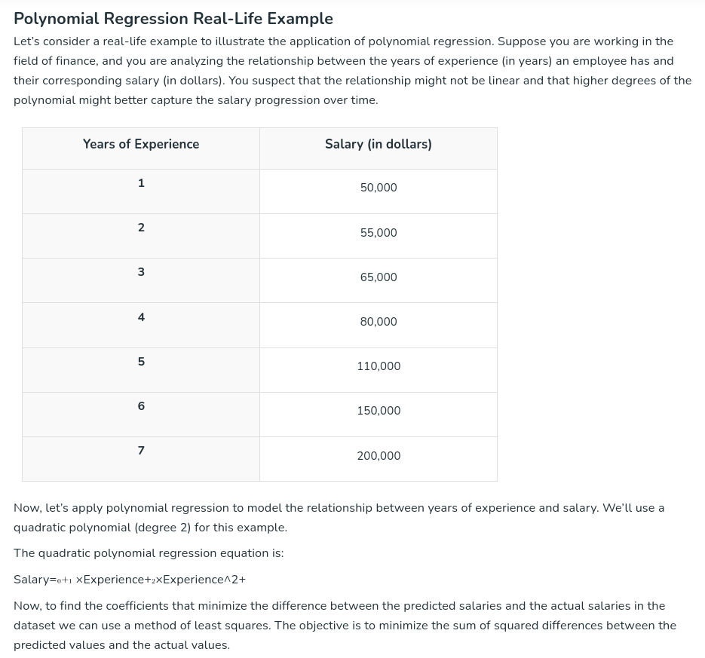

Slide 7
Cost Function
Cost functions (also known as loss functions) are crucial in machine learning for evaluating how well a model is performing. They guide the optimization process by quantifying the difference between predicted and actual values.

Slide 8
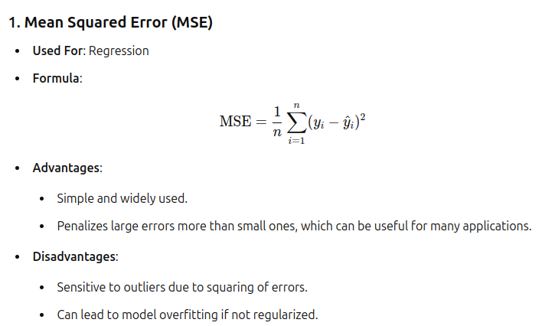

Slide 9
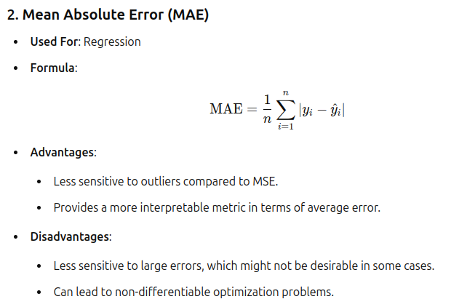

Slide 10
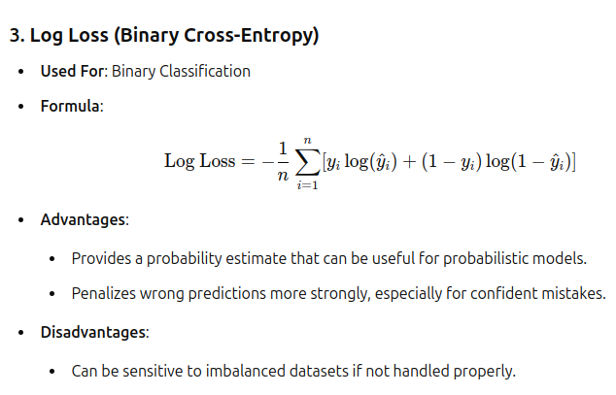

Slide 11
Logistic Regression in Machine Learning
Shorouk Ahmed

Slide 12
What is Logistic Regression?
- Logistic Regression is a statistical method for binary classification.
- Used to predict the probability of a binary outcome (0 or 1).
- Commonly used in various fields such as finance, healthcare, and marketing.

Slide 13
Applications of Logistic Regression
- Medical diagnosis (e.g., predicting disease presence).
- Credit scoring and fraud detection.
- Marketing (e.g., predicting customer churn).

Slide 14
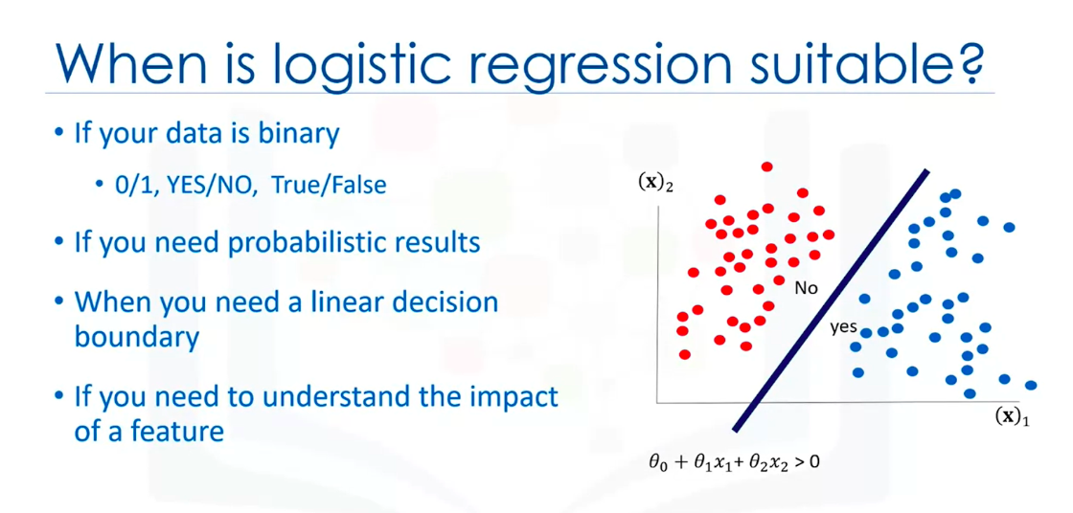

Slide 15
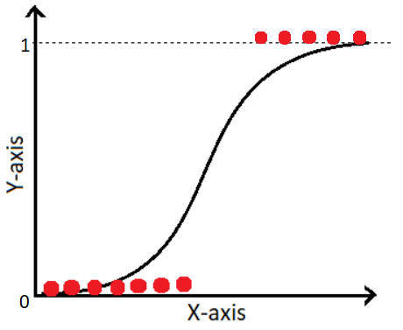
Logistic vs. Linear Regression
- Linear Regression: Predicts continuous values.
- Logistic Regression: Predicts probabilities for binary outcomes.

Slide 16

The Logistic (Sigmoid) Function
Equation: σ(z) = 1 / (1 + e^-z)
- Maps any real-valued number into the [0, 1] interval.
- Probability threshold (commonly 0.5) for classification.

Slide 17
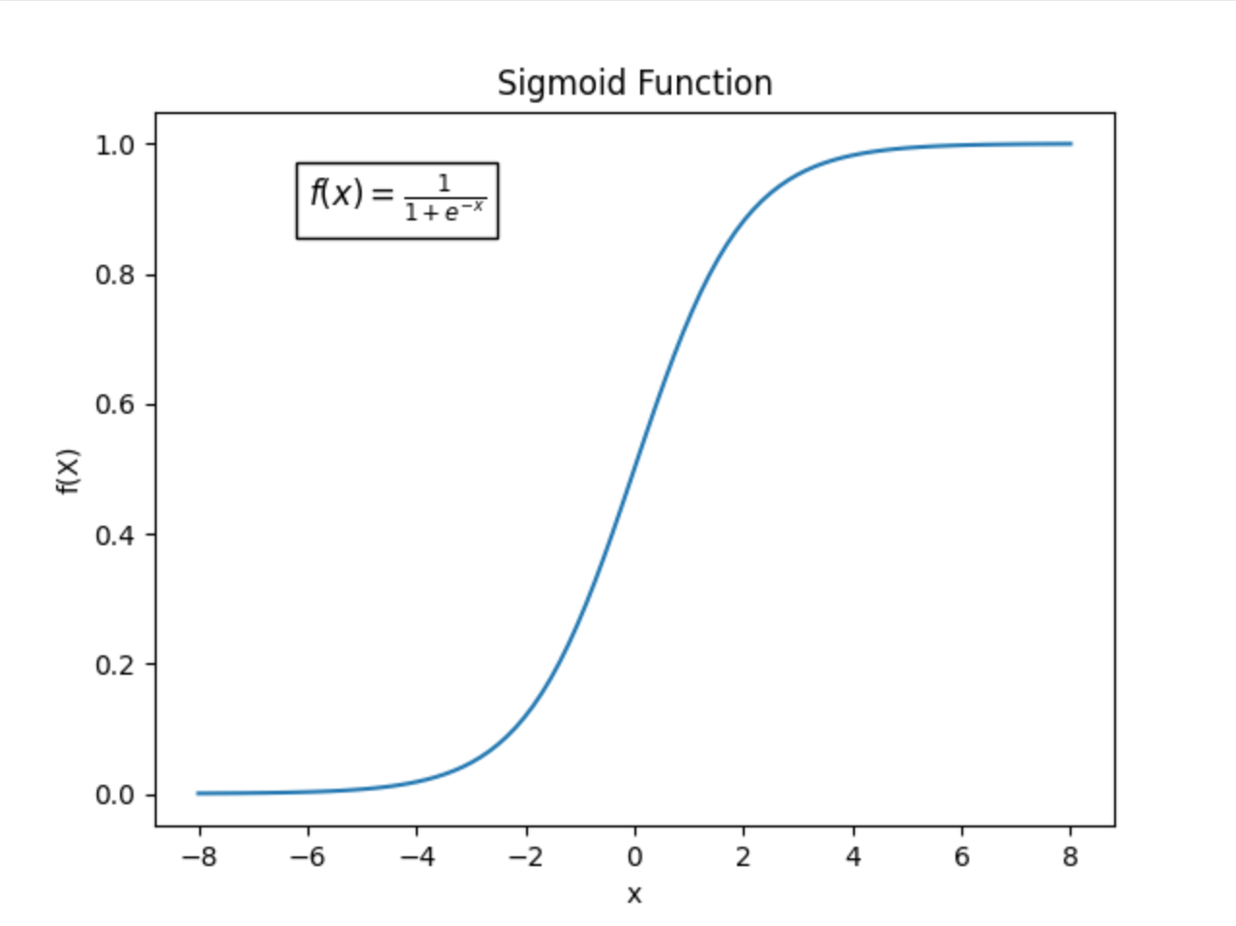

Slide 18

Training the Logistic Regression Model
- Cost function (log-loss or cross-entropy loss).
- Gradient Descent optimization: Gradient descent is an optimization algorithm used to minimize the cost function in logistic regression (and many other machine learning algorithms). The goal is to find the optimal parameters (weights) that minimize the cost function.

Slide 19
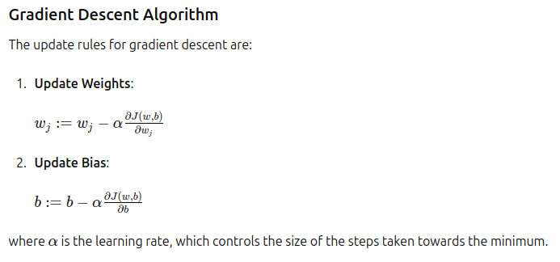

Slide 20
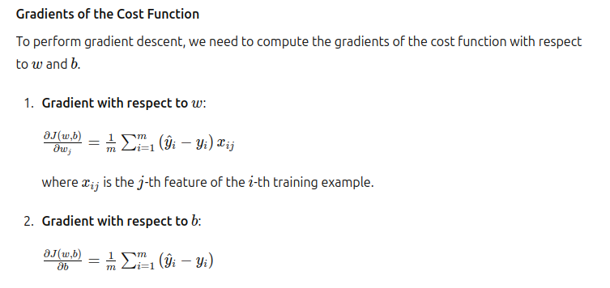

Slide 21
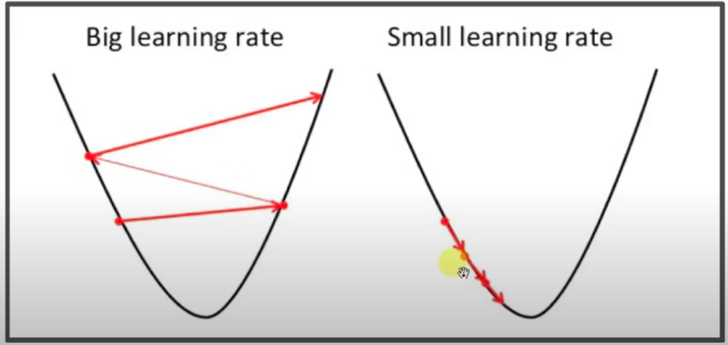

Slide 22
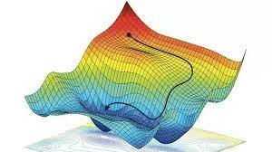
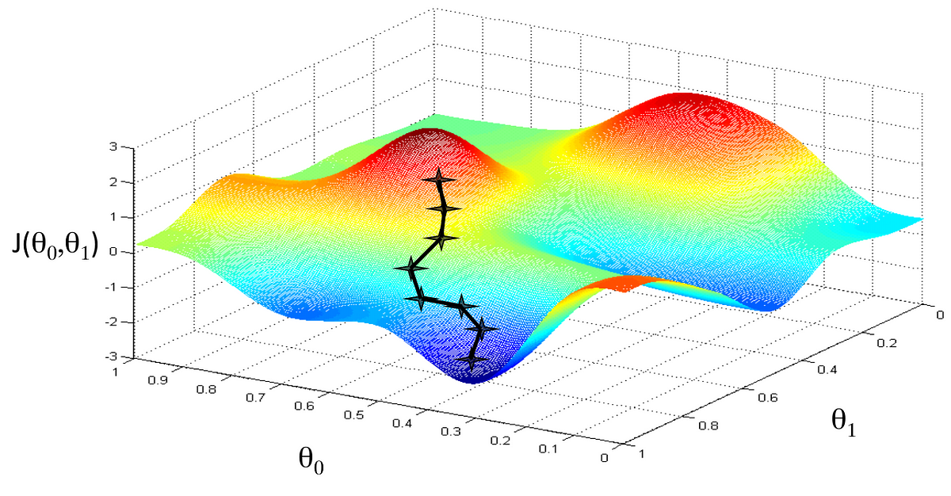

Slide 23
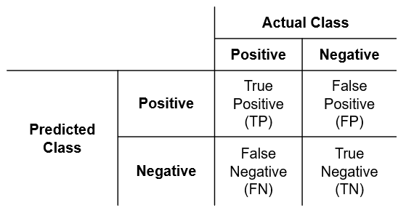
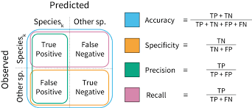

Evaluation Metrics in Classification
Used to assess the performance and effectiveness of a statistical or machine learning model

Slide 24
ROC Curve (Receiver Operating Characteristic Curve)
The ROC Curve (Receiver Operating Characteristic Curve) is a fundamental tool used in evaluating the performance of a classification model, especially in binary classification problems.This curve plots two parameters: True Positive Rate. False Positive Rate.

Slide 25
AUC (Area Under the Curve)
Definition: The Area Under the ROC Curve (AUC) is a single scalar value that summarizes the overall performance of the model. It represents the probability that the model will correctly rank a randomly chosen positive instance higher than a randomly chosen negative instance.
Range: AUC values range from 0 to 1, where:
1: Perfect model.
0.5: No discriminative power (random guessing).
< 0.5: Model is worse than random guessing (usually a sign that the model is poorly trained or has a problem).

Slide 26
